Slide 1

A Generalized Bulk Parameterization Approach for Land-Atmosphere Heat Fluxes
Sreenath Paleri^{1,2}, Tilden Meyers², Temple Lee² and Mark Heuer²
¹CIWRO,University of Oklahoma
²NOAA Air Resources Laboratory, Atmospheric Turbulence and Diffusion Division
AMS Annual Conference: SMOI
16 January 2025

Slide 2

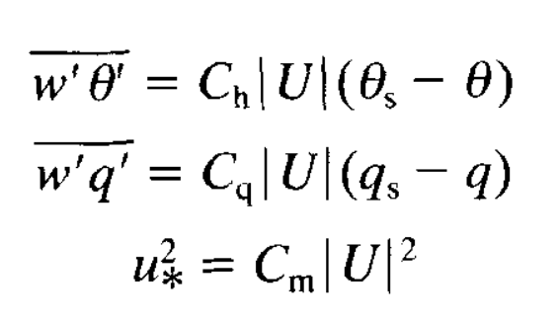
Bulk aerodynamic method
Stull 1993; Taylor 1916

Slide 3
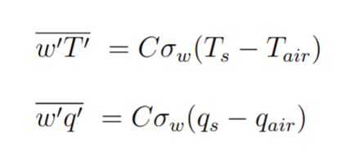
Revised bulk parameterisation for heat fluxes

Slide 4
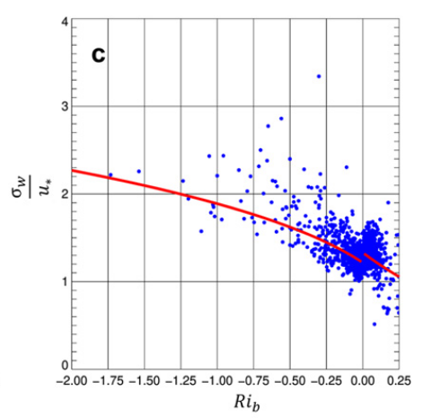



Revised bulk parameterisation for heat fluxes
Unstable, Rib < 0
Stable, Rib > 0
Lee and Meyers 2023

Slide 5
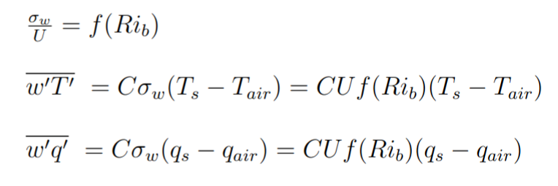
Revised bulk parameterisation for heat fluxes

Slide 6
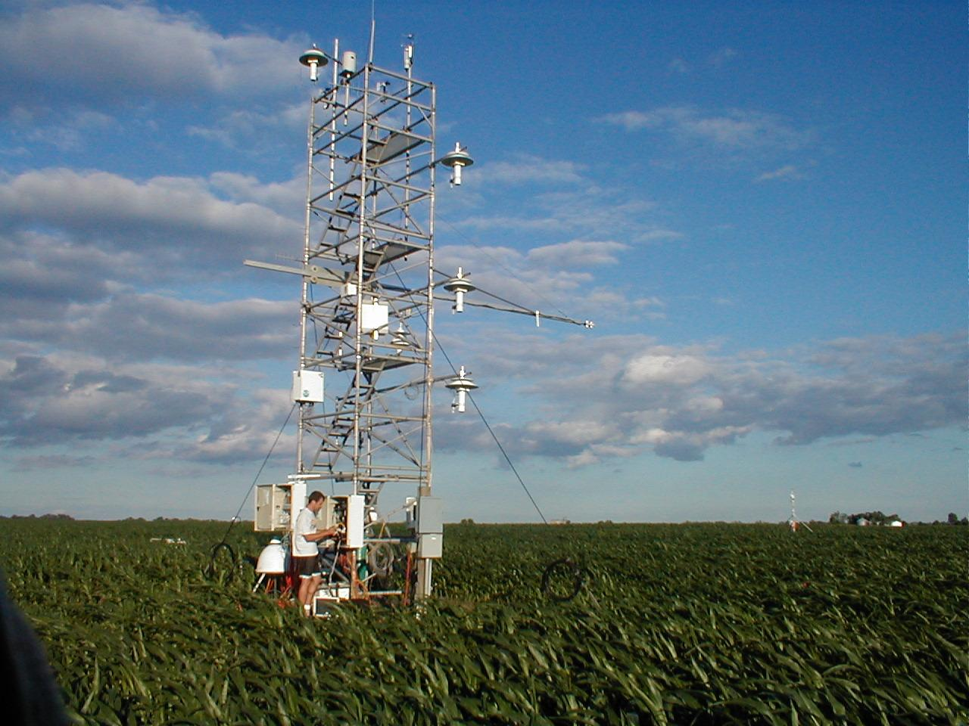
ARL Surface FLux Station, Bondville, IL
Installed June 2001
3 level wind and Ta profiles
4-component radiometer
Uniform Soybean/corn canopy

Slide 7
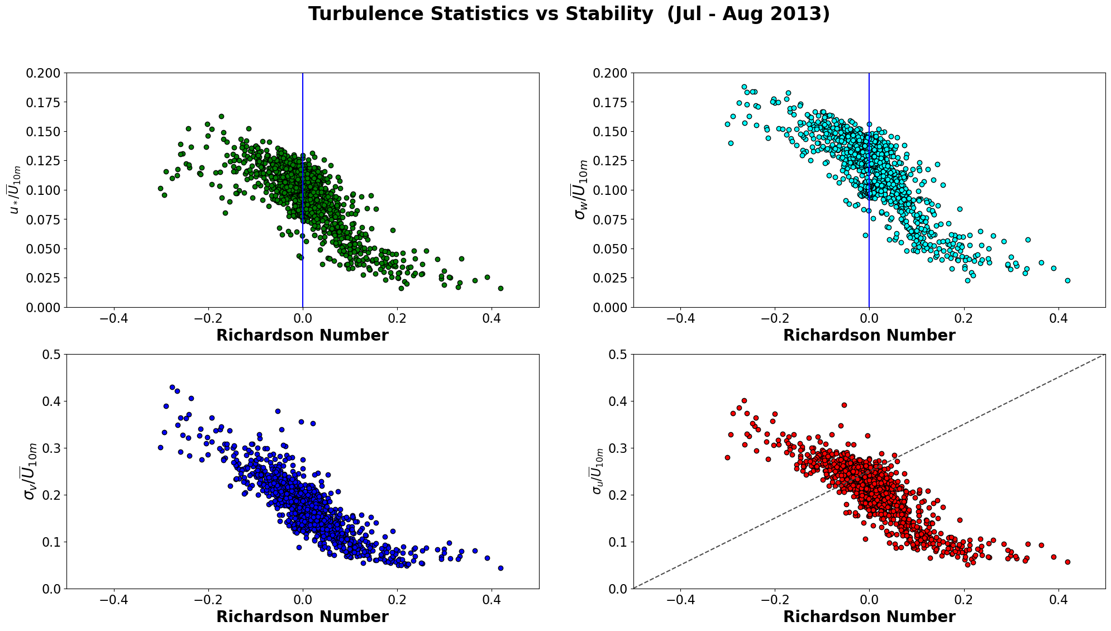


Slide 8
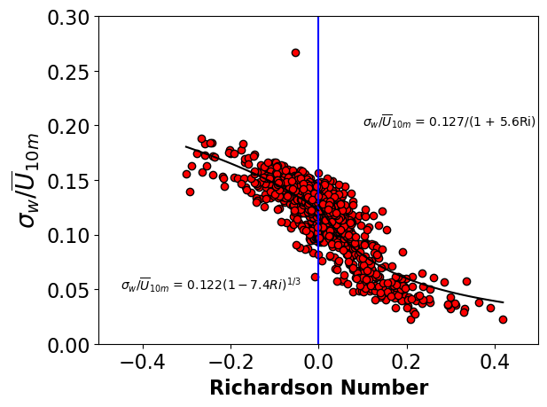


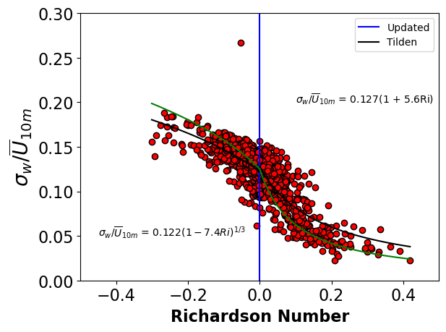
Scaling relationship

Slide 9
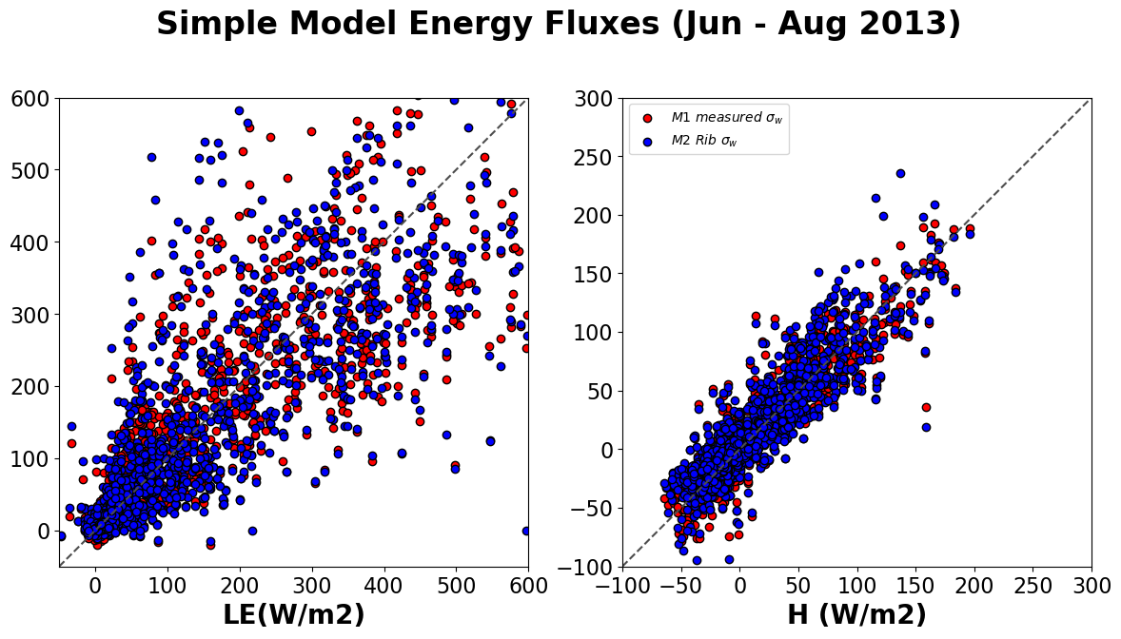
Fully parameterized fluxes BNV Jul - Aug 2013
M1
M2

Slide 10
How well does this hold up for complex sites?

Slide 11
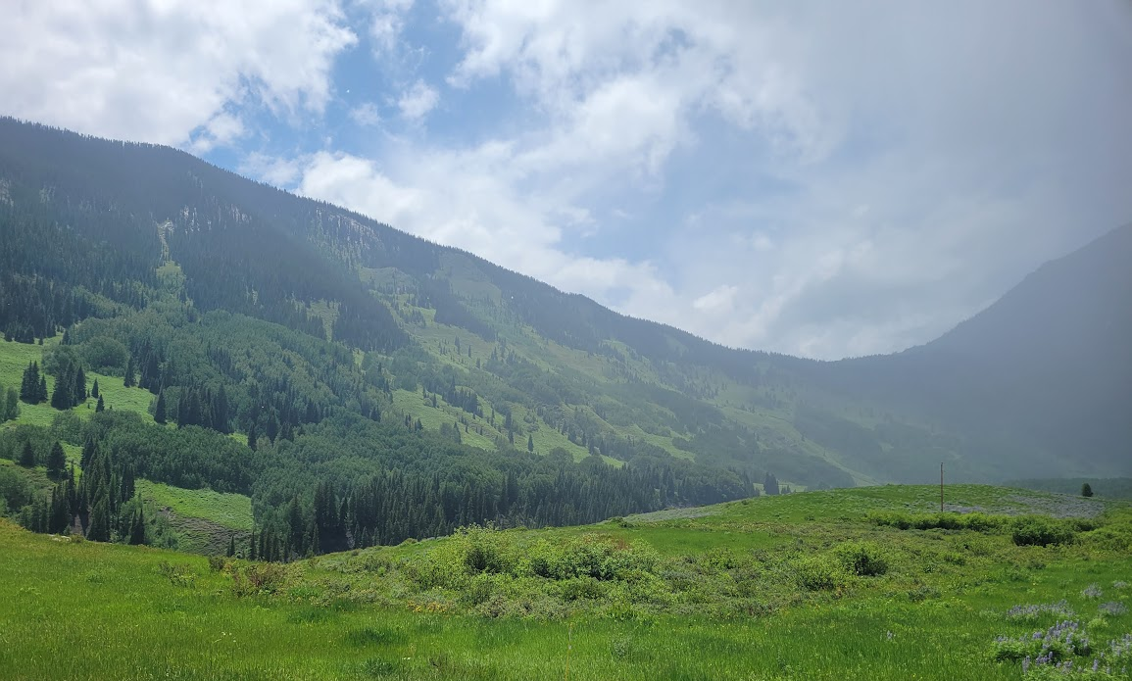

ARL Surface FLux Station, Crested Butte, CO

Slide 12
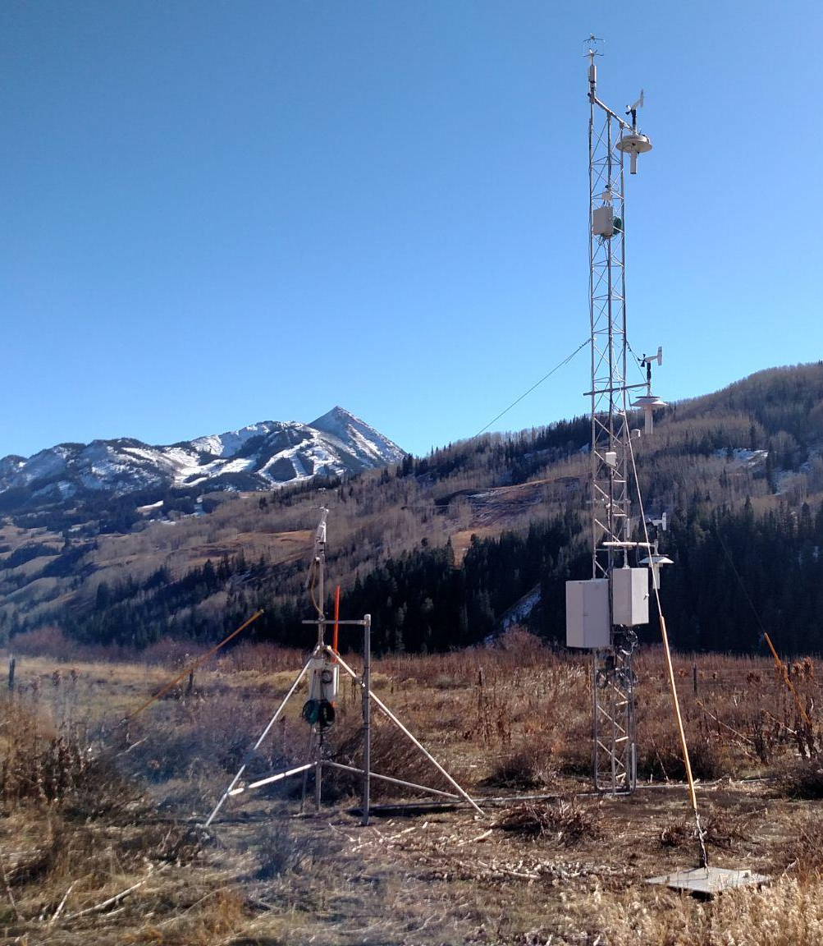
Eddy covariance at 3 and 10 m
LI-7500 DS for H2O and CO2
Smartflux system with RM Young VRE Sonic
EddyPro processing software
10 Hz sampling, output 30 minute average

Slide 13
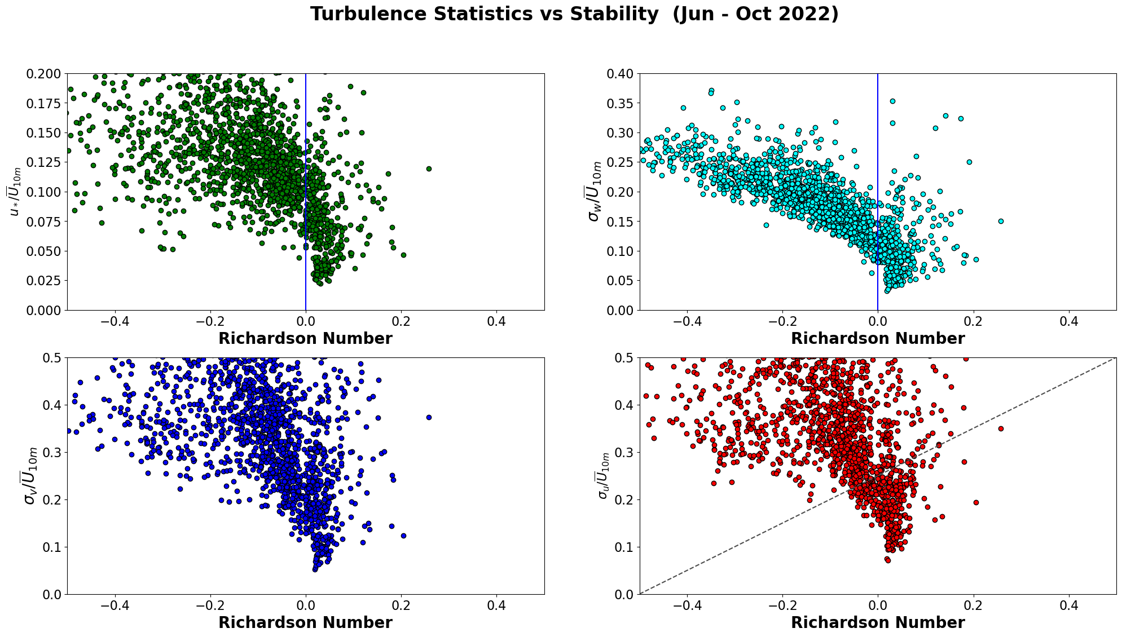
Complicated stable conditions
Much more scatter for u,v, u*

Slide 14
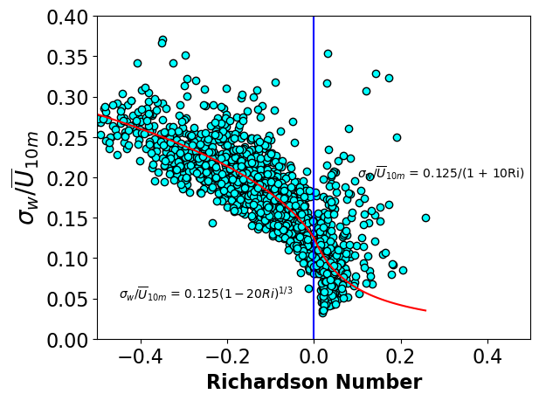

Slide 15
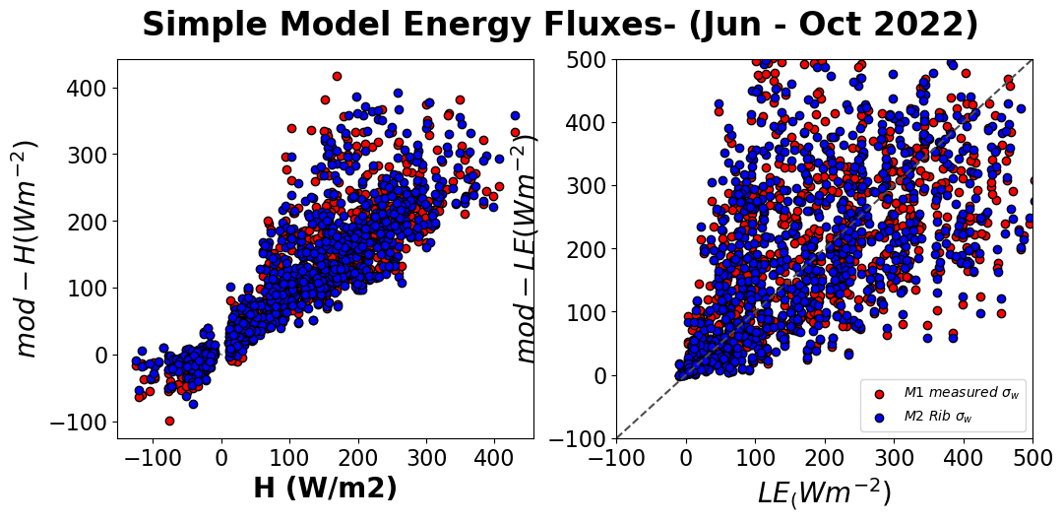
M1
M2

Slide 16
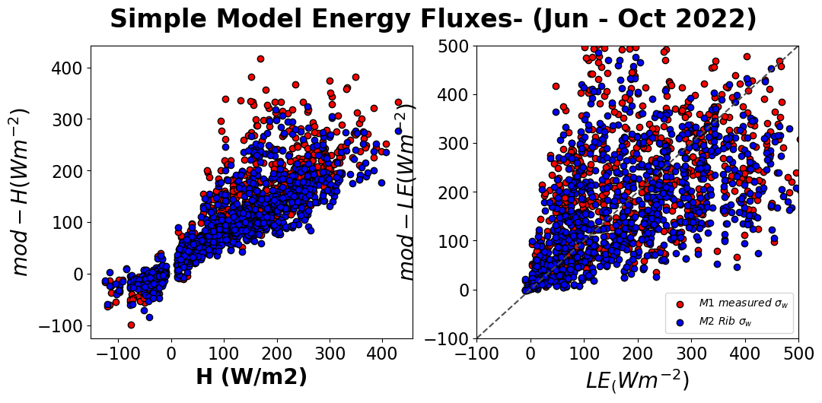
Using the BNV formulation
M1
M2

Slide 17

Conclusions
σ_{w}/U can be written as a function of the bulk Richardson number, easier to measure routinely with vertical gradients and gap fill data
Formulation from an ‘ideal’ site could be extended to more complex sites and fetches
We still need some prior data from the particular field station to estimate the ‘bulk coefficient’
Refine calculations for LE and q_{s}
Investigate the dependence on Ts

Slide 18
Thank you!
sreenath.paleri@noaa.gov
spaleri@ou.edu

Slide 19
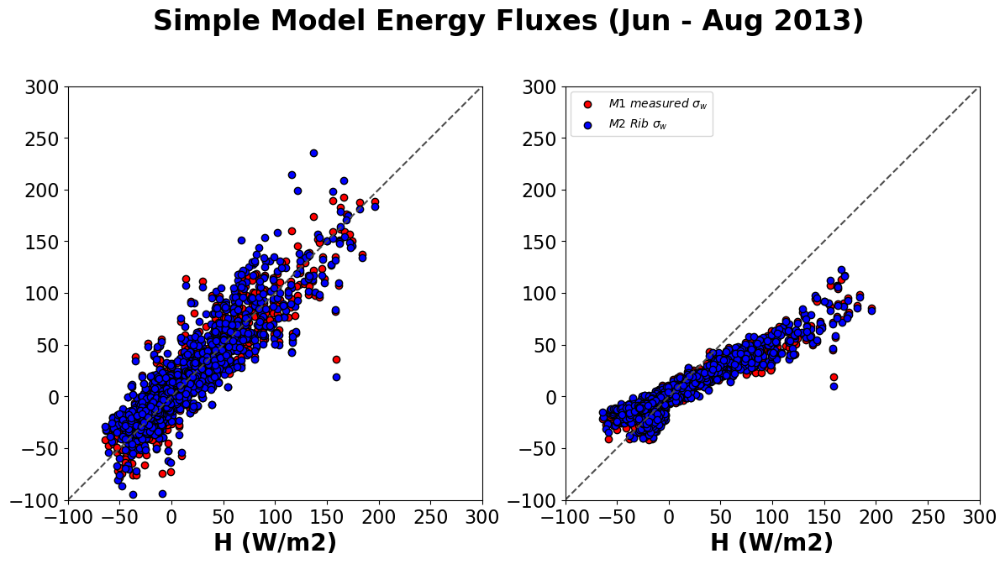
Fully parameterized fluxes BNV, comparing 2m air temp.
The modeled H is lower.
Need to capture the higher surface temps
How imp is it to use our improved method?
Will mostly move this to extra slides for now.

Slide 20
a) BNV
b) KP

Slide 21
How well does this hold up for complex sites?
How imp. Is it to get the surface temperatures?

